Slide 1
IKAS--晶合MVA分析汇报
—— Case5、6

Slide 2
01
IKAS—晶合MVA Case5/6

Slide 3
28HPC Product EM 1V DS&US Fail Case DOE spilt table
 |  | pi-run qual |  |  |  | wave 1.0 qual |  | wave 1.5 qual |  |  | wave 2.0 qual |  |  |  | TQV
 |  | NAZ415#06 | NAZ415#08 | NAZ415#12 | NAZ415#13 | NAZ439#03 | NAZ439#06 | NAZ703#01 | NAZ703#08 | NAZ703#09 | NBX082#05 | NBX082#12 | NBX082#15 | NBX082#16 | NBX219#17
M1 | TiN dep | POR | POR | POR | POR | POR | POR | POR | POR | POR | POR | POR | POR | POR | POR
 | PHOTO | POR | POR | POR | POR | POR | POR | POR | POR | new PR | 12点+1nm | 12点+1nm | 12点+1nm | 12点+1nm | new PR
 | OX ETCH | R19 | R23 | R19 | R23 | R19 | R19 | R19 | R19 | R19 | R19 | R19 | R19 | R19 | R19
 | WET clean | POR | POR | POR | POR | POR | POR | POR | POR | POR | POR | new chemical | new chemical | new chemical | new chemical
 | B/S dep | 350 | 350 | 350 | 350 | 435 | 435 | 435 | 435 | 435 | APC+16/14 | APC+16/14 | APC+16/14 | APC+16/14 | APC+16/14
 | ECP | 旧POR | 旧POR | 旧POR | 旧POR | 旧POR | 旧POR | 旧POR | 3in1 | 3in1 | 3in1+ multiwave | 3in1+ multiwave | 3in1+ multiwave | 3in1+ multiwave | 3in1+ multiwave
 | CMP | POR | POR | BGM4 | BGM4 | BGM4 | BGM4 | POR | POR | POR | BGM4' | BGM4' | BGM4' | BGM4' | BGM4'
M2/1V | Photo | POR | POR | POR | POR | POR | POR | POR | POR | POR | POR | POR | POR | POR | New PR
 | TiN dep | POR | POR | POR | POR | POR | POR | POR | POR | POR | POR | POR | AMAT CIP | NAURA CIP | POR
 | HM ETCH | POR | POR | POR | POR | POR | POR | POR | POR | POR | POR | CDU improve | CDU improve | CDU improve | POR
 | OX ETCH | R18 | R19 | R18 | R19 | R18 | R20 | R18 | R18+PET | R18+U% CIP | R22 | R22 | R22 | R22 | R22
 | B/S dep | 350A | 350A | 350A | 350A | 350A | APC+435A | 350A | 400A+ low bias | 400A+ low bias | APC+ 18.4/14.7 | APC+ 18.4/14.7 | APC+ 18.4/14.7 | APC+ 18.4/14.7 | APC+ 18.4/14.7
 | ECP | 旧POR | 旧POR | 旧POR | 旧POR | 旧POR | 旧POR | 旧POR | 3in1 | 3in1 | 3in1+ multiwave | 3in1+ multiwave | 3in1+ multiwave | 3in1+ multiwave | 3in1+ multiwave
 | CMP | POR | POR | POR | POR | BGM4 | BGM4 | POR | POR | POR | BGM4 | BGM4 | BGM4 | BGM4 | BGM4
Downstream | life time (year) | 0.9 | 0.4 | 0.1 | 0.3 | 11.2 | 7.3 | 2.0 | 7.4 | 1.4 | 0.7 | 0.4 | 0.6 | 0.3 | 2.84
 | σ | 1.07 | 1.24 | 1.52 | 1.33 | 0.81 | 0.73 | 0.94 | 0.68 | 0.83 | 0.86 | 1.1 | 0.88 | 0.94 | 0.91
Upstream | life time (year) | 12.9 | 12.4 | 15.5 | 10.8 | 8.4 | 1.3 | 9.6 | 60.1 | 61.6 | 0.3 | 0.7 | 0.5 | 0.0 | 1.75
 | σ | 1.01 | 0.77 | 0.93 | 0.77 | 1.27 | 1.35 | 1.07 | 0.63 | 0.63 | 0.94 | 0.83 | 0.9 | 1.87 | 0.51

Slide 4
Case5/6 MVA 分析目标
背景
EM 1V DS/US testing fail @2023/1/31 ~ 2023/10/10
目标
通过Good/Bad Wafer的EM数据进行对比找出DOE优势分组建议
分析不同DOE分组条件与DS/US数据的关联性
G/B wafer inline data差异
结合业内know-how，给出新的DOE分组建议
整理报告，输出结果并给出建议

Slide 5
Case5/6 MVA 分析结论
结论
M2 B/S dep (400A+low bias) + ECP (3in1) 对upstream的巨大提升
M1 B/S dep 值小，对于upstream的提升有优势
M1/M2 CMP BGM4 recipe对于downstream的提升有优势
影响downstream最大的inline站点为1V.PQW10, 1U.CDG10, 1V.EQW10 等
影响upstream最大的inline站点为1U.CDG10, 1U.CDG20, 1U.PQW10等
同时影响US/DS且权重较大的站点为1U.CDG10, 1U.PQW10, 1V.PQX10, 1V.PQX20, 2U.PQX10
上下分区inline分析发现，MAP的好坏和inline OVL直接相关
建议
降低B/S dep可能有助于避免void的产生，void可能导致DS/US值大幅降低
CMP(BGM4) + M2 B/S dep (400A+low bias) + ECP (3in1) 的组合有可能达到理想效果

Slide 6
G/B wafer inline数据洞查----Case5（对DS有较大影响）
OPE_NO RECIPE | INLINE_PARAMETER_ID | Score | Score AVG
1V.PQW10 FPNM301/FPNM3011VR FPNR901/FPNR9011VR_0B0J ADI CD MEAS | 16W0 | 1 | 0.994976488
 | 17W0 | 0.999999999
 | 14W0 | 0.999999999
 | 15W0 | 0.999999864
 | DNW10 | 0.999048836
 | 34W0 | 0.996929913
 | 32W0 | 0.996844915
 | 28W0 | 0.996706698
 | 30W0 | 0.996634558
 | 35W0 | 0.994916156
 | DNW08 | 0.990321048
 | YSIG | 0.968315871
1U.CDG10 RJLTUL100010AXX TEOS DEPOSITION | TSW0 | 0.997170245 | 0.990758826
 | PEW0 | 0.984347407
1V.EQW10 FPNM301/FPNM3011VE10 FPNR901/FPNR9011VE_0B0J ASI TRENCH CD MEAS | 23W0 | 0.999905318 | 0.979558774
 | 14W0 | 0.998662667
 | 02W0 | 0.997497349
 | 06W0 | 0.995619706
 | 22W0 | 0.994298374
 | 30W0 | 0.989389137
 | 40W0 | 0.983521529
 | 42W0 | 0.978375225
 | 41W0 | 0.978266249
 | 31W0 | 0.975170469
 | 11W0 | 0.973860121
 | 43W0 | 0.969480923
 | 10W0 | 0.969185178
 | 26W0 | 0.959098548
 | XSIG | 0.956324211
 | 27W0 | 0.954285387
OPE_NO RECIPE | INLINE_PARAMETER_ID | Score | Score AVG
1V.PQX10 L2800Z1N/1VFPNM31 L2800Z2N/1VFPNR91-B-L28W3F1 L2800Z1N/1VFPNM31-L28W3F1 OVL MEASUREMENT L1 | YDW0 | 0.996628044 | 0.97351033
 | ABW0 | 0.992926311
 | YMW0 | 0.979921032
 | A2W0 | 0.97939942
 | MY01 | 0.971368093
 | AGW0 | 0.970886549
 | AYW0 | 0.964320793
 | IYW0 | 0.953383627
 | MY02 | 0.9527591
1V.PQX20 L2800Z1N/1VFPNR31-L2 L2800Z2N/1VFPNR91-L2 OVL MEASUREMENT L2 | Y8W0 | 0.967029843 | 0.967029843
2U.PQW10 FPNM301/FPNM3012UR FPNR901/FPNR9012UR_0B0J ADI CD MEAS | 31W0 | 0.972548598 | 0.96631357
 | 29W0 | 0.968999926
 | 34W0 | 0.96858799
 | 30W0 | 0.967708107
 | 32W0 | 0.967232817
 | 27W0 | 0.966927718
 | 33W0 | 0.966926667
 | 40W0 | 0.96563077
 | 44W0 | 0.964866276
 | 42W0 | 0.964761253
 | 28W0 | 0.964682794
 | 45W0 | 0.964673144
 | 41W0 | 0.962993795
 | 43W0 | 0.96185012
2U.PQX10 L2800Z1N/2UFPNM31 L2800Z2N/2UFPNR91-B-L28W3F1 L2800Z1N/2UFPNM31-L28W3F1 OVL MEASUREMENT L1 | A7W0 | 0.962319614 | 0.962319614
1U.PQW10 FPNM301/FPNM3011UR FPNR901/FPNR9011UR_0B0J ADI CD MEAS | 18W0 | 0.950660547 | 0.950660547
 | 03W0 | 0.950660547
跳转Case6

Slide 7
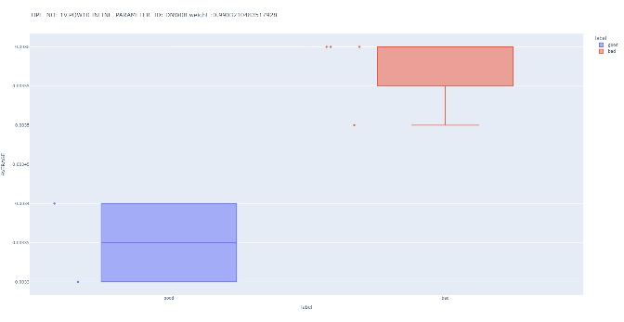
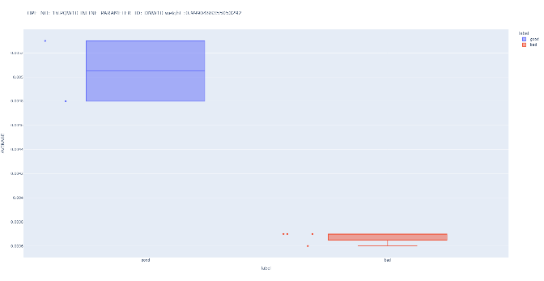
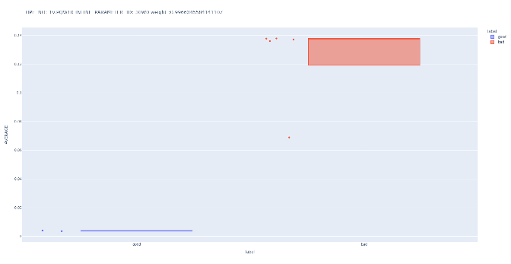
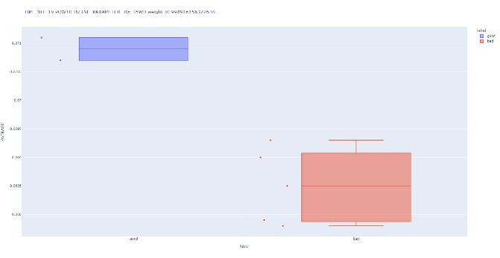
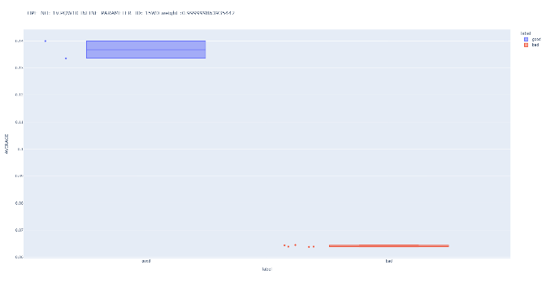
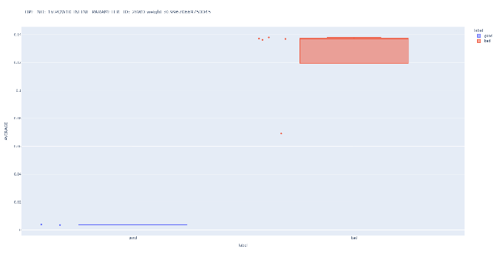
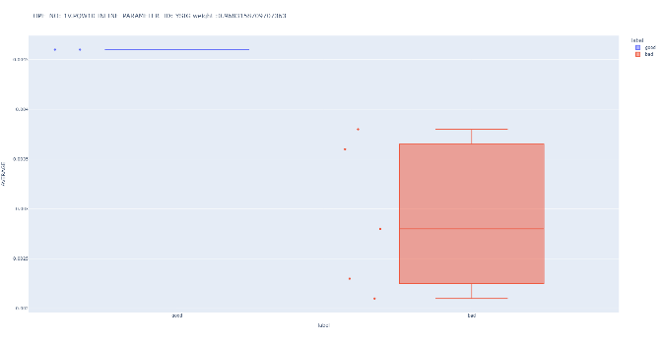
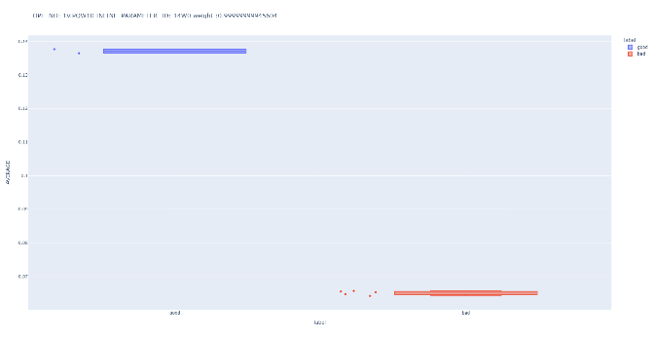

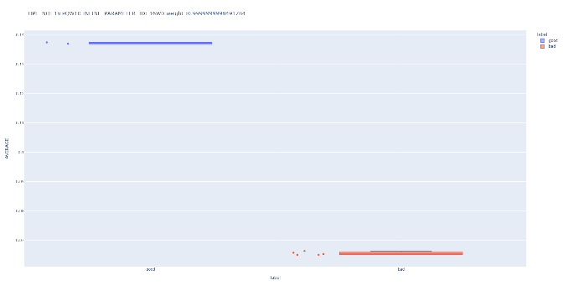
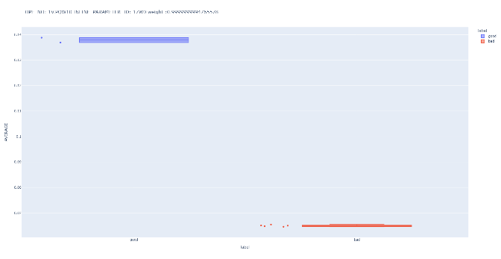

G/B wafer inline数据洞查----1V.PQW10 ADI CD MEAS
Good：
Bad：

Slide 8
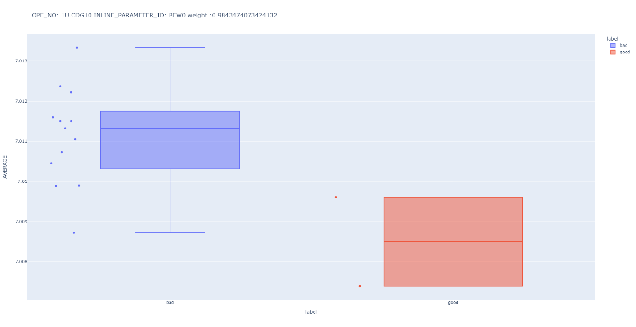
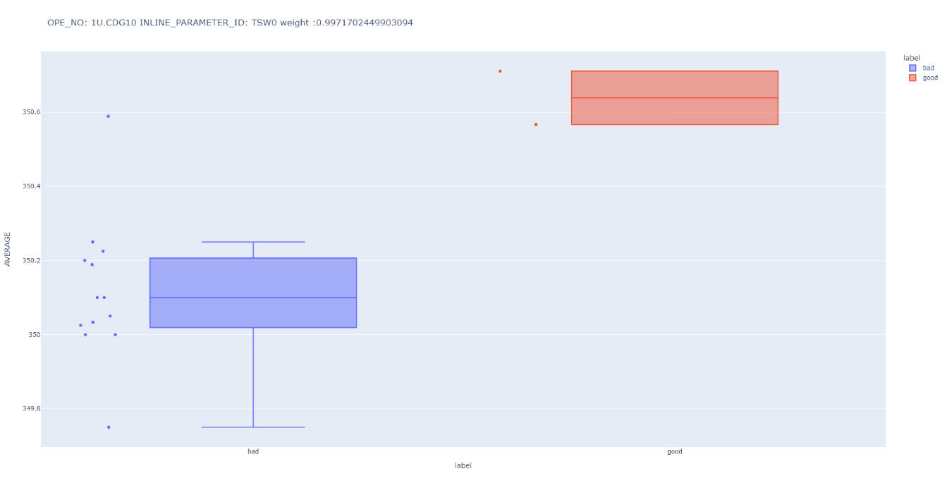
G/B wafer inline数据洞查----1U.CDG10 TEOS DEPOSITION
Good：
Bad：

Slide 9
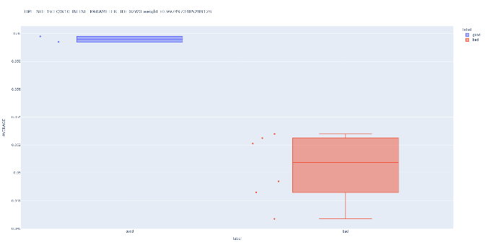
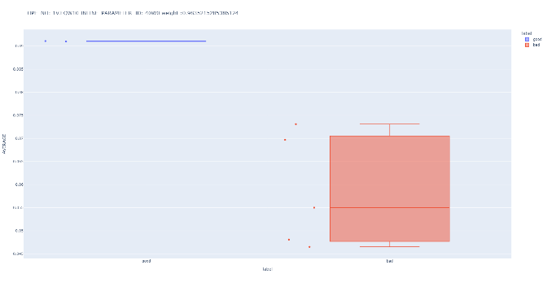
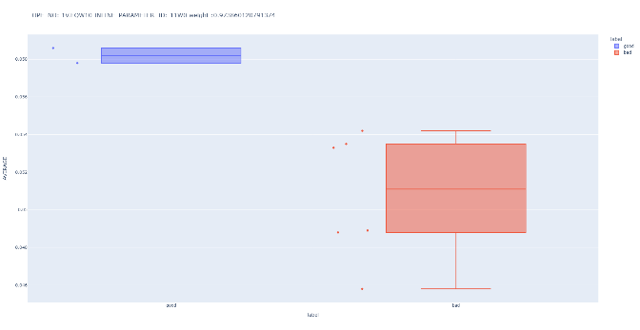
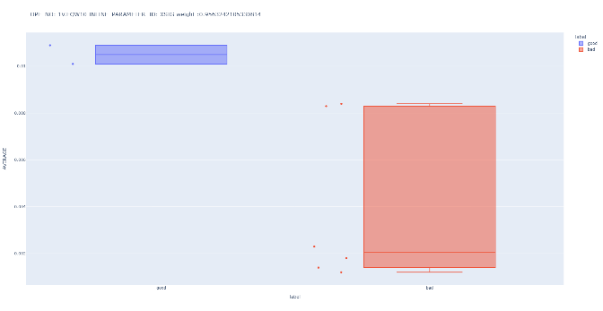
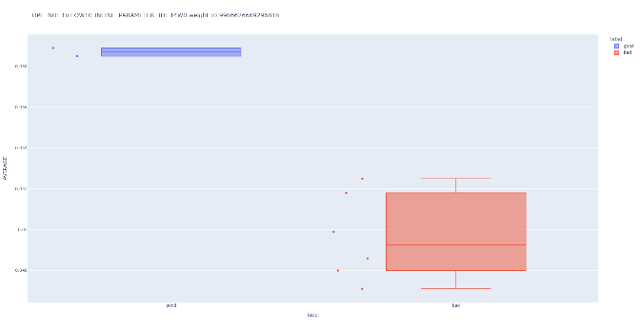
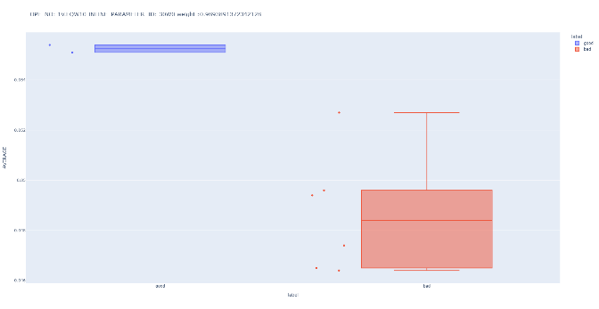
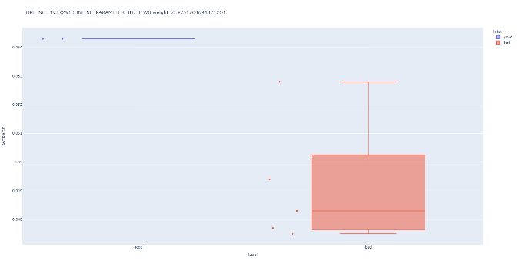
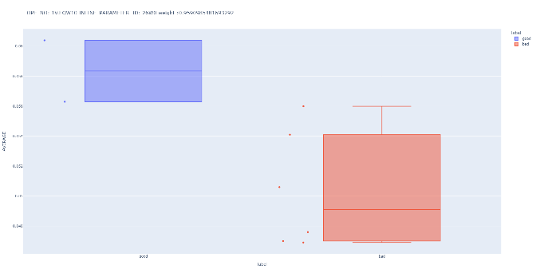
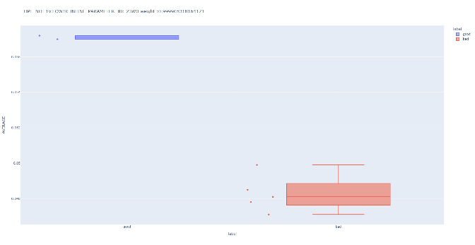
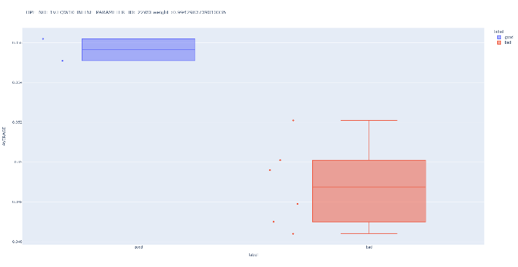
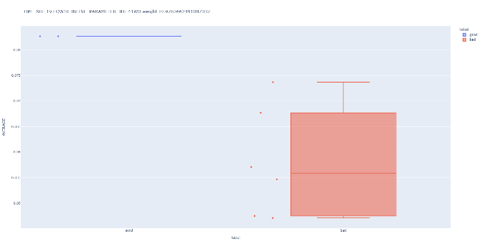
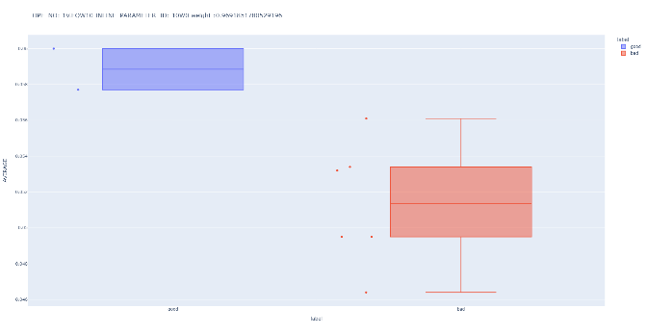
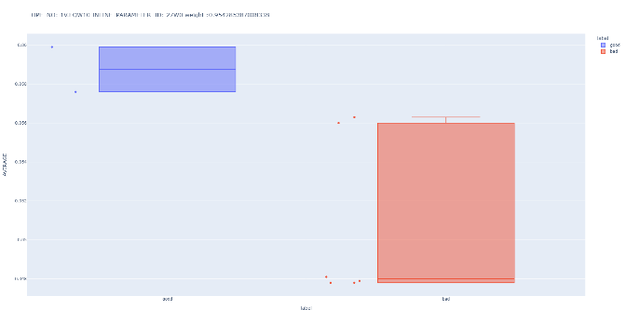
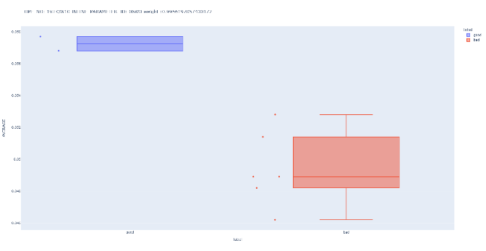


G/B wafer inline数据洞查----1V.EQW10 ASI TRENCH CD MEAS
Good：
Bad：

Slide 10
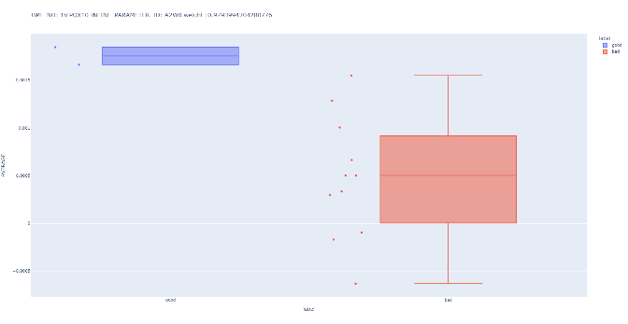
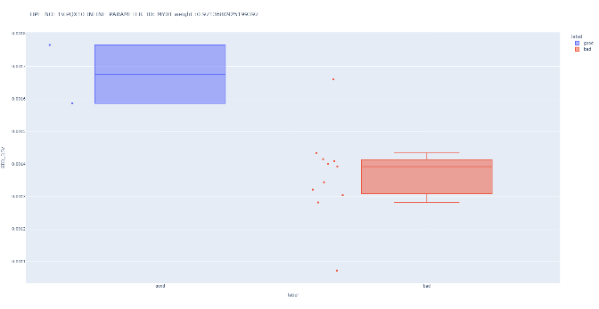
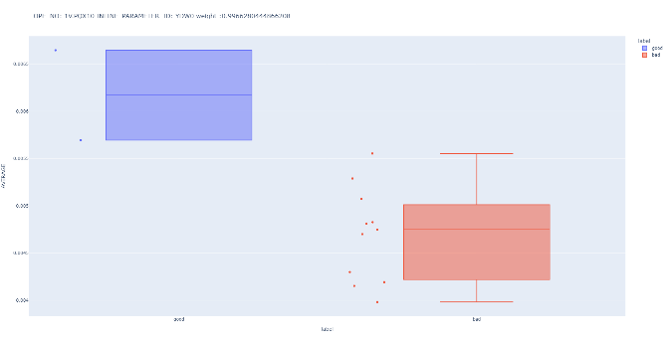
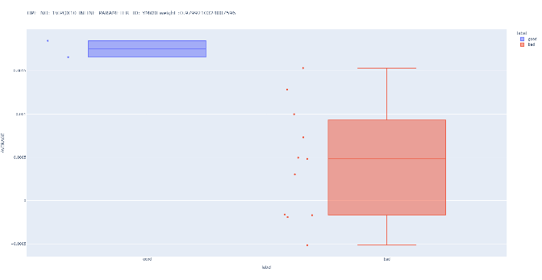
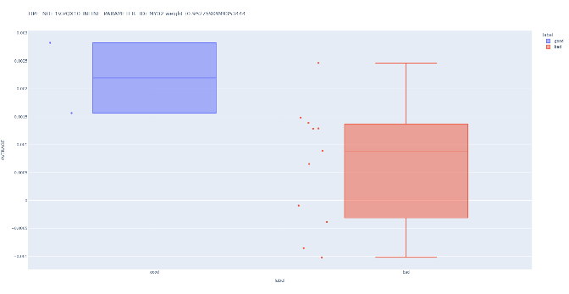
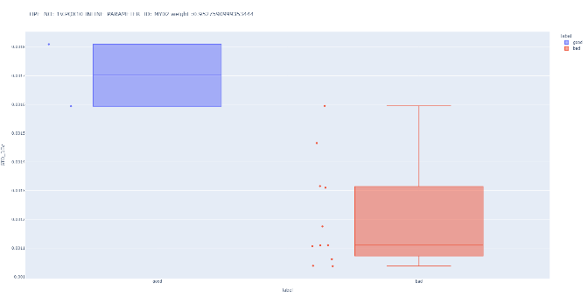
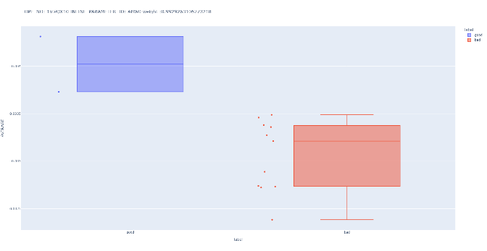
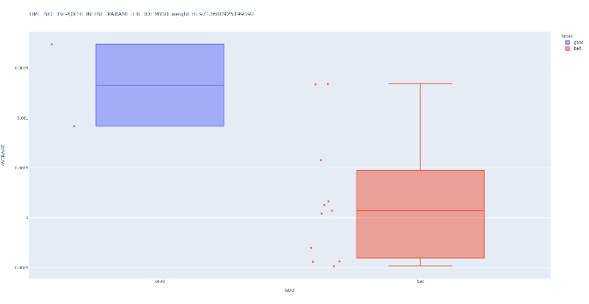
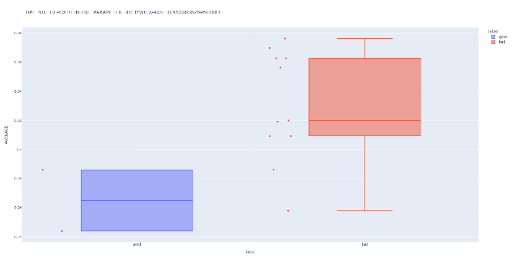
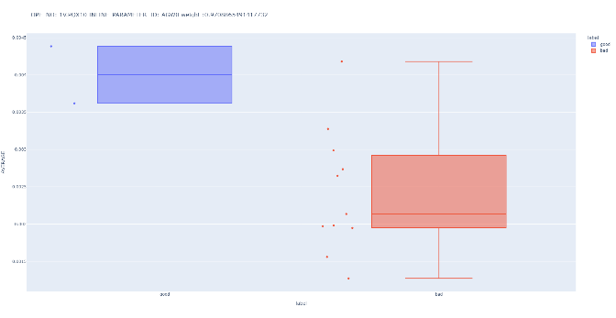
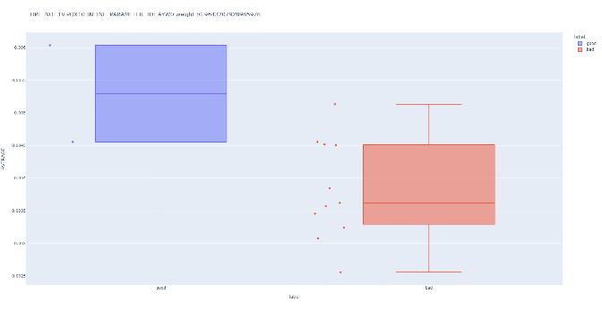
G/B wafer inline数据洞查----1V.PQX10 OVL MEASUREMENT L1
Good：
Bad：

Slide 11
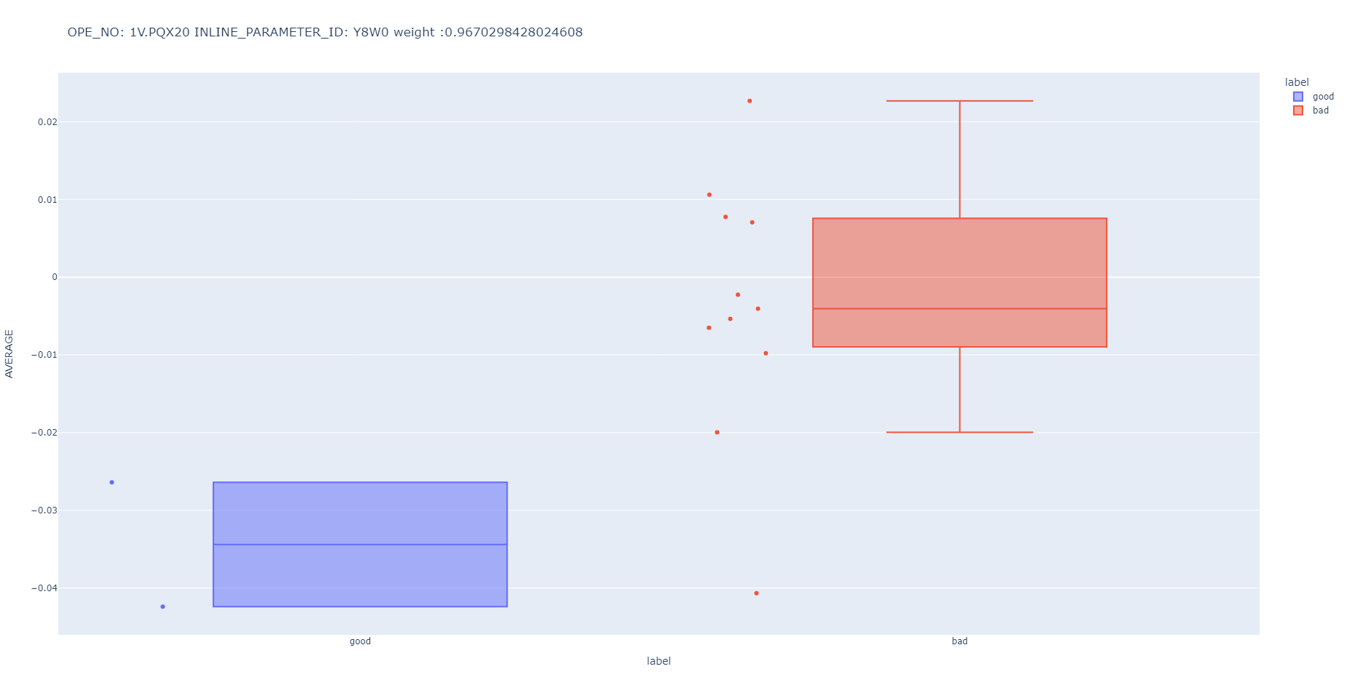
G/B wafer inline数据洞查----1V.PQX20 OVL MEASUREMENT L2
Good：
Bad：

Slide 12
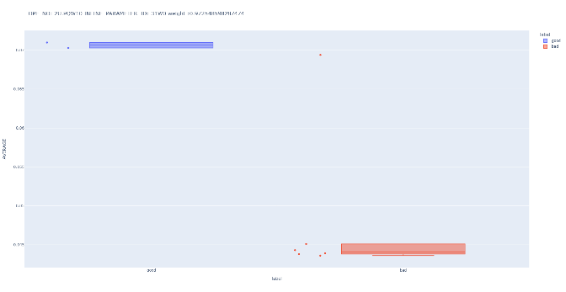
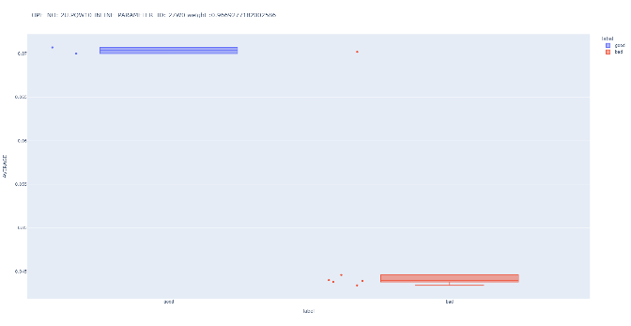
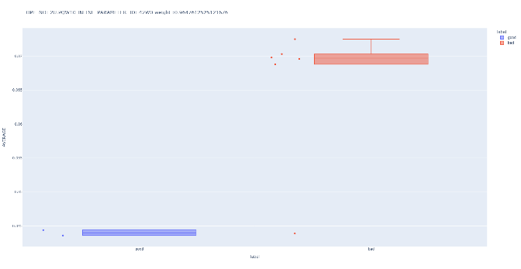
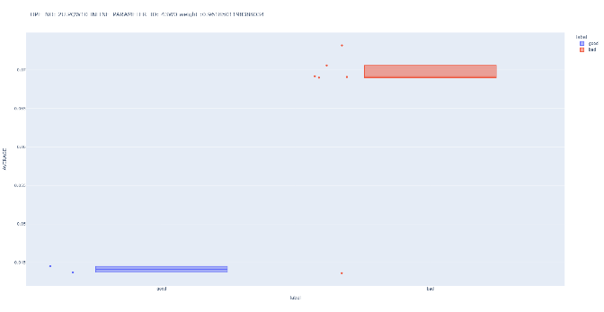
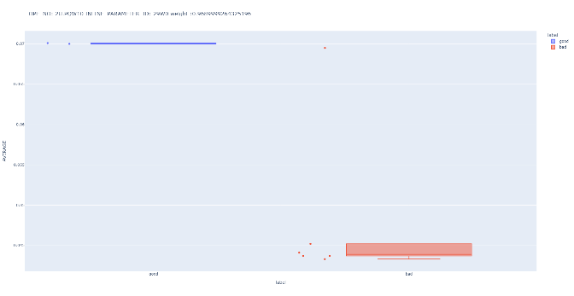
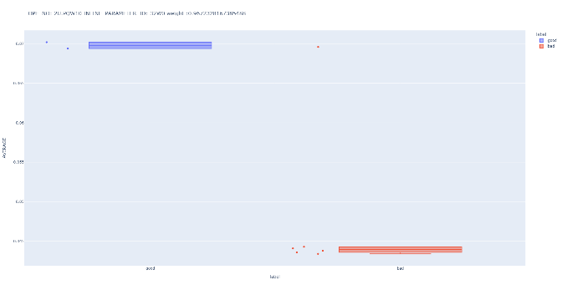
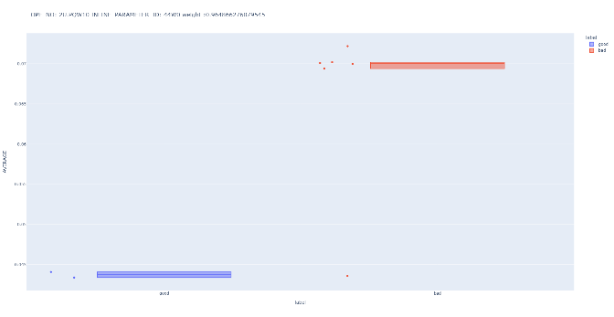
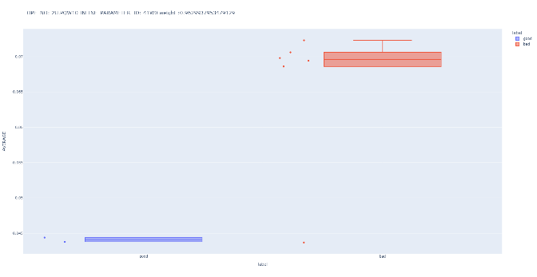
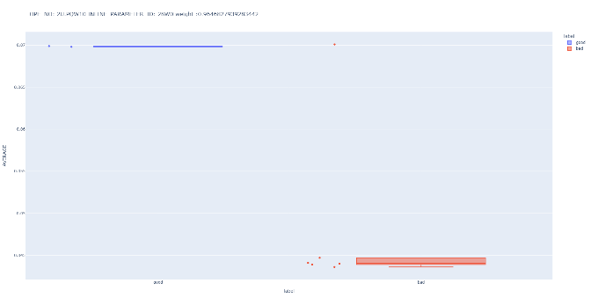
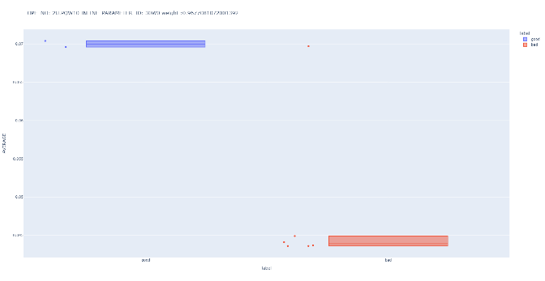
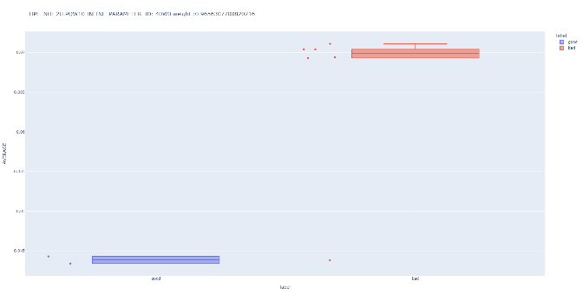
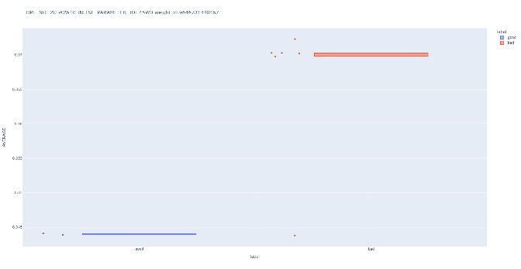


G/B wafer inline数据洞查----2U.PQW10 ADI CD MEAS
Good：
Bad：

Slide 13

G/B wafer inline数据洞查----2U.PQX10 OVL MEASUREMENT L1
Good：
Bad：

Slide 14


G/B wafer inline数据洞查----1U.PQW10 ADI CD MEAS
Good：
Bad：

Slide 15
G/B wafer inline数据洞查----Case6（对US有较大影响）
OPE_NO RECIPE | INLINE_PARAMETER_ID | Score | Score AVG
1U.CDG10 RJLTUL100010 TEOS DEPOSITION | CIW0 | 1 | 0.9874925
 | REW0 | 0.99922088
 | FEW0 | 0.991001745
 | HFT0 | 0.989553105
 | SEW0 | 0.957686985
1U.CDG20 RJLTUL100030 OX CAP DEPOSITION | CIW0 | 1 | 0.9831763
 | EEW0 | 0.982641293
 | PTW0 | 0.966887546
1U.PQW10 FPNM301/FPNM3011UR ADI CD MEAS | 09W0 | 0.976812243 | 0.9637364
 | 45W0 | 0.950660547
1U.PQX10 L2800Z1N/1UFPNM31 OVL MEASUREMENT L1 | AJW0 | 0.967103854 | 0.965766
 | B5W0 | 0.964428186
1V.ECU10 RJ28CUV11V1FPNM301_CD RJ28PFPNM301C1VU2_CD CU CMP | TGS1 | 0.952436309 | 0.9524363
1V.PQX10 L2800Z1N/1VFPNM31 L2800Z2N/1VFPNR91-B-L28W3F1 OVL MEASUREMENT L1 | WIW0 | 1 | 0.9802854
 | A8W0 | 0.993973956
 | AJW0 | 0.993888381
 | ADW0 | 0.98886412
 | WBW0 | 0.983963349
 | MPW0 | 0.977631319
 | X8W0 | 0.975166772
 | SAW0 | 0.958125537
 | FX03 | 0.950955179
OPE_NO RECIPE | INLINE_PARAMETER_ID | Score | Score AVG
1V.PQX20 L2800Z1N/1VFPNR31-L2 L2800Z2N/1VFPNR91-L2 OVL MEASUREMENT L2 | WIW0 | 1 | 0.978877736
 | JYW0 | 0.985185909
 | MPW0 | 0.977631319
 | IYW0 | 0.97218709
 | YTW0 | 0.959384363
2U.CDG10 RJLTUL100010 TEOS DEPOSITION | CIW0 | 1 | 0.983884416
 | HFT0 | 0.996098069
 | SEW0 | 0.955555179
2U.CDG20 RJLTUL100010 TEOS DEPOSITION | CIW0 | 1 | 0.993757955
 | PTW0 | 0.990658352
 | HFT0 | 0.990615512
2U.EQW10 FPNM301/FPNM3012UE10 FPNR901/FPNR9012UE_0B0J AMI CD MEAS | 33W0 | 0.992710312 | 0.982035175
 | 06W0 | 0.971360038
2U.PQX10 L2800Z1N/2UFPNM31 L2800Z2N/2UFPNR91-B-L28W3F1 OVL MEASUREMENT L1 | WIW0 | 1 | 0.972179762
 | WBW0 | 0.999240457
 | MPW0 | 0.977631319
 | FX02 | 0.971842216
 | FX01 | 0.969641172
 | SAW0 | 0.955540514
 | FY01 | 0.952800173
 | FX04 | 0.950742242
跳转Case5

Slide 16




G/B wafer inline数据洞查----1U.CDG10 TEOS DEPOSITION
Good：
Bad：

Slide 17


G/B wafer inline数据洞查----1U.CDG20 OX CAP DEPOSITION
Good：
Bad：

Slide 18


G/B wafer inline数据洞查----1U.PQW10 ADI CD MEAS
Good：
Bad：

Slide 19


G/B wafer inline数据洞查----1U.PQX10 OVL MEASUREMENT L1
Good：
Bad：

Slide 20

G/B wafer inline数据洞查----1V.ECU10 CU CMP
Good：
Bad：

Slide 21









G/B wafer inline数据洞查----1V.PQX10 OVL MEASUREMENT L1
Good：
Bad：

Slide 22




G/B wafer inline数据洞查----1V.PQX20 OVL MEASUREMENT L2
Good：
Bad：

Slide 23


G/B wafer inline数据洞查----2U.CDG10 TEOS DEPOSITION
Good：
Bad：

Slide 24


G/B wafer inline数据洞查----2U.CDG20 TEOS DEPOSITION
Good：
Bad：

Slide 25


G/B wafer inline数据洞查----2U.EQW10 AMI CD MEAS
Good：
Bad：

Slide 26











G/B wafer inline数据洞查----2U.PQX10 OVL MEASUREMENT L1
Good：
Bad：

Slide 27
Wafer 上下分区inline分析结果（不包括TQV）
分析流程：
按照用户给的wafer list，不分good bad wafer；
按照用户给的坐标点位，记site4、8、9、12、13为上半区；site2、6、7、10、11为下半区输入到inline分析模型中计算。
分析结论：
权重较高的项目，均为OVL MEASUREMENT
OPE_NO | weight
1V.PQX10 OVL MEASUREMENT L1 | 0.323533983
1V.PQX20 OVL MEASUREMENT L2 | 0.245150236
1U.PQX10 OVL MEASUREMENT L1 | 0.190459208
2U.PQX10 OVL MEASUREMENT L1 | 0.152420836
1V.PQX30 OVL MEASUREMENT L3 | 0.088435737

Slide 28

1V.PQX10----OVL MEASUREMENT L1
上半区：
下半区：

Slide 29

1V.PQX20----OVL MEASUREMENT L2

Slide 30











1U.PQX10 OVL MEASUREMENT L1

Slide 31


2U.PQX10----OVL MEASUREMENT L1

Slide 32
G/B wafer inline数据洞查----Case5（对DS有较大影响）（不包括TQV）
OPE_NO | weight
1V.PQW10 ADI CD MEAS | 0.239643068
1U.CDG10 TEOS DEPOSITION | 0.192133294
1V.EQW10 ASI TRENCH CD MEAS | 0.174165488
1V.PQX10 OVL MEASUREMENT L1 | 0.127533883

Slide 33

1V.PQW10----ADI CD MEAS

Slide 34

1U.CDG10----TEOS DEPOSITION

Slide 35

1V.EQW10----ASI TRENCH CD MEAS

Slide 36

1V.PQX10----OVL MEASUREMENT L1

Slide 37
G/B wafer inline数据洞查----Case6（对US有较大影响）（不包括TQV）
OPE_NO | weight
1U.CDG10 TEOS DEPOSITION | 0.199248869
1U.CDG20 OX CAP DEPOSITION | 0.193978069
2U.CDG20 OX CAP DEPOSITION | 0.173931191
2U.CDG10 TEOS DEPOSITION | 0.172486689

Slide 38

1U.CDG10----TEOS DEPOSITION

Slide 39

1U.CDG20----OX CAP DEPOSITION

Slide 40

2U.CDG20----OX CAP DEPOSITION

Slide 41

2U.CDG10----TEOS DEPOSITION

